Slide 1
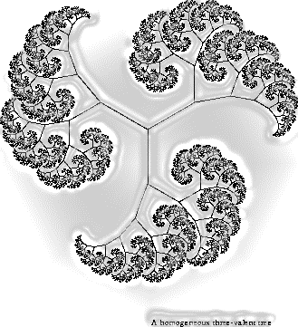

AUM $Mατh Clμβ$
Friday, February 3, 2017
1:00pm – 2:00pm
Goodwyn Hall Room 204
Discussion:
Introduction
Plans for Semester
N-Body Problem
Math Jeopardy
Math Videos
And
More
Open and free to all AUM students and faculty
Snacks and refreshments provided

