Slide 1
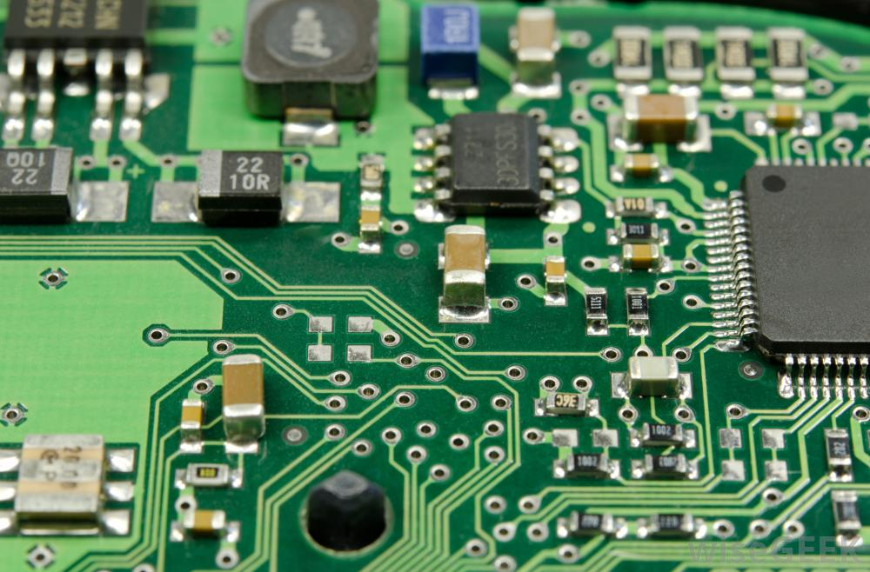
ACM (Association for Computing Machinery) AUM Student Chapter
Join the Computer Science Club for our Fall semester kickoff meeting!
Itinerary:
New Friends!
Free Food!
Lunch
Meet and Greet
Discuss Spring officer elections
Brainstorm club project ideas
Friday, August 30, 2019
12:30-2:00 PM
Goodwyn Hall Room 201
Open and free to all AUM students and faculty.
Pizza and refreshments will be provided!

